Slide 1

Docker Overview

Slide 2
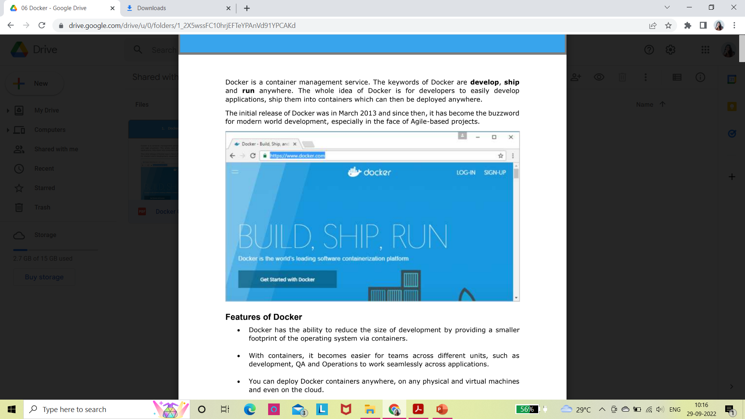
Docker
Docker is a container management service. The keywords of Docker are develop, ship and run anywhere.
The whole idea of Docker is for developers to easily develop applications, ship them into containers which can then be deployed anywhere.
The initial release of Docker was in March 2013 and since then, it has become the buzzword for modern world development, especially in the face of Agile-based projects.

Slide 3
Features of Docker
Docker has the ability to reduce the size of development by providing a smaller footprint of the operating system via containers.
With containers, it becomes easier for teams across different units, such as development, QA and Operations to work seamlessly across applications.
We can deploy Docker containers anywhere, on any physical and virtual machines and even on the cloud.
Since Docker containers are pretty lightweight, they are very easily scalable.

Slide 4
Components of Docker
Docker has the following components:-
Docker for Mac – It allows one to run Docker containers on the Mac OS.
Docker for Linux - It allows one to run Docker containers on the Linux OS.
Docker for Windows - It allows one to run Docker containers on the Windows OS.
Docker Engine – It is used for building Docker images and creating Docker containers.
Docker Hub – This is the registry which is used to host various Docker images.
Docker Compose – This is used to define applications using multiple Docker containers.

Slide 5
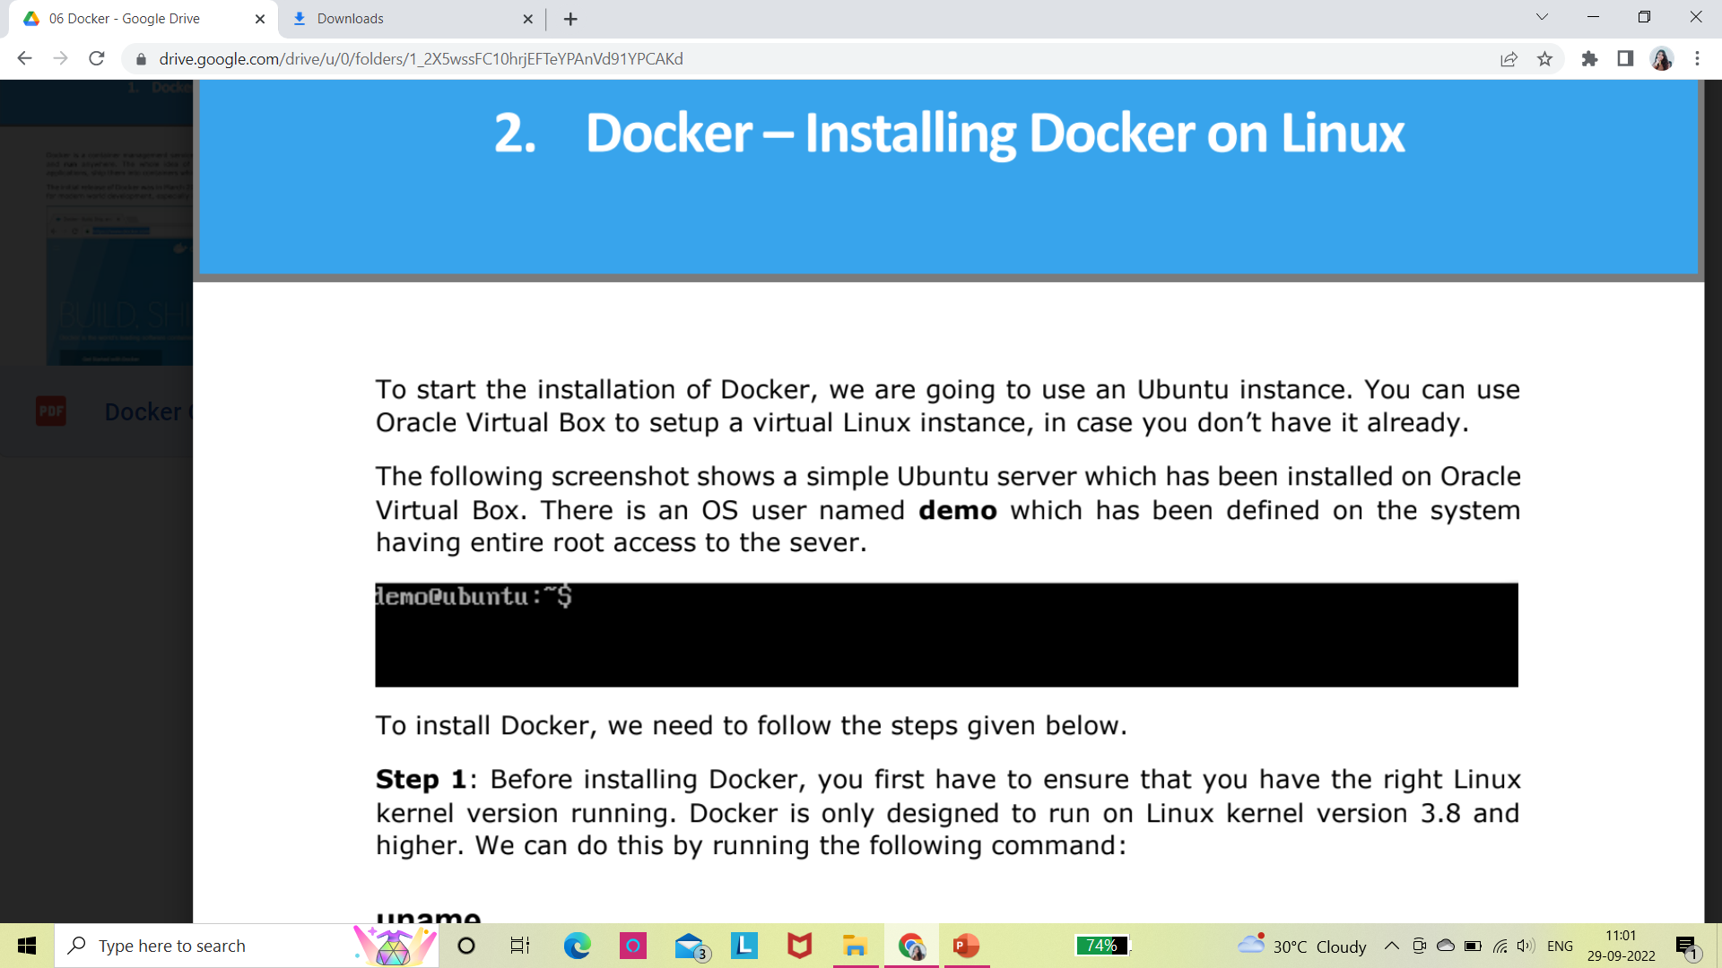
Docker – Installing Docker on Linux
To start the installation of Docker, we are going to use an Ubuntu instance.
We can use Oracle Virtual Box to setup a virtual Linux instance, in case you don’t have it already.
The above image shows a simple Ubuntu server which has been installed on Oracle Virtual Box. There is an OS user named demo which has been defined on the system having entire root access to the sever.

Slide 6
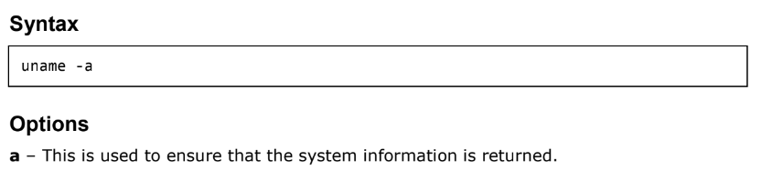
Steps to install the Docker:
STEP 1: We first have to ensure that we have the right Linux kernel version running. Docker is only designed to run on Linux kernel version 3.8 and higher. We can do this by running the following command:
uname method returns the system information about the Linux system.

Slide 7
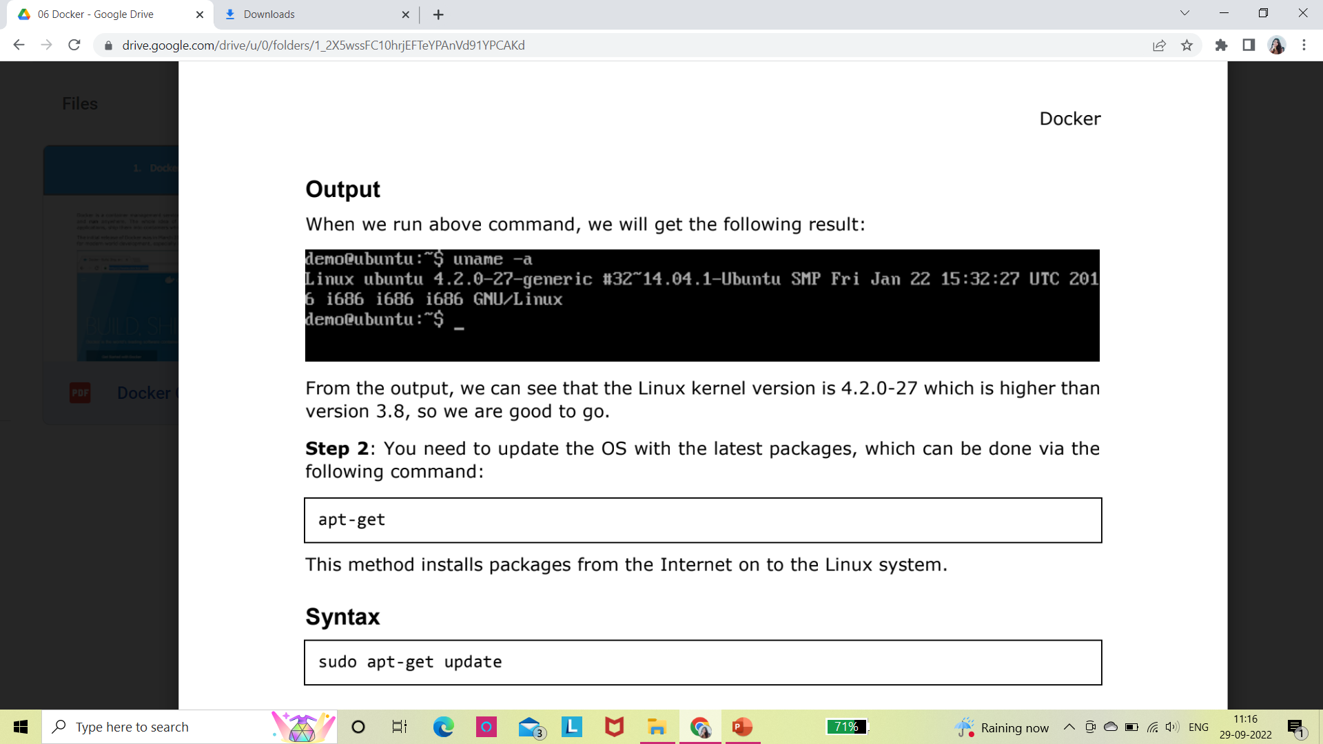
Return Value
This method returns the following information on the Linux system:
kernel name
node name
kernel release
kernel version
machine
processor
hardware platform
operating system
Example
uname –a
Output
From the output, we can see that the Linux kernel version is 4.2.0-27 which is higher than
version 3.8, so we are good to go.

Slide 8
STEP 2: We need to update the OS with the latest packages, which can be done via the following command:
apt-get
This method installs packages from the Internet on to the Linux system.
Syntax
sudo apt-get update
sudo - The sudo command is used to ensure that the command runs with root access.
update - The update option is used ensure that all packages are updated on the Linux system.
Return Value
None

Slide 9
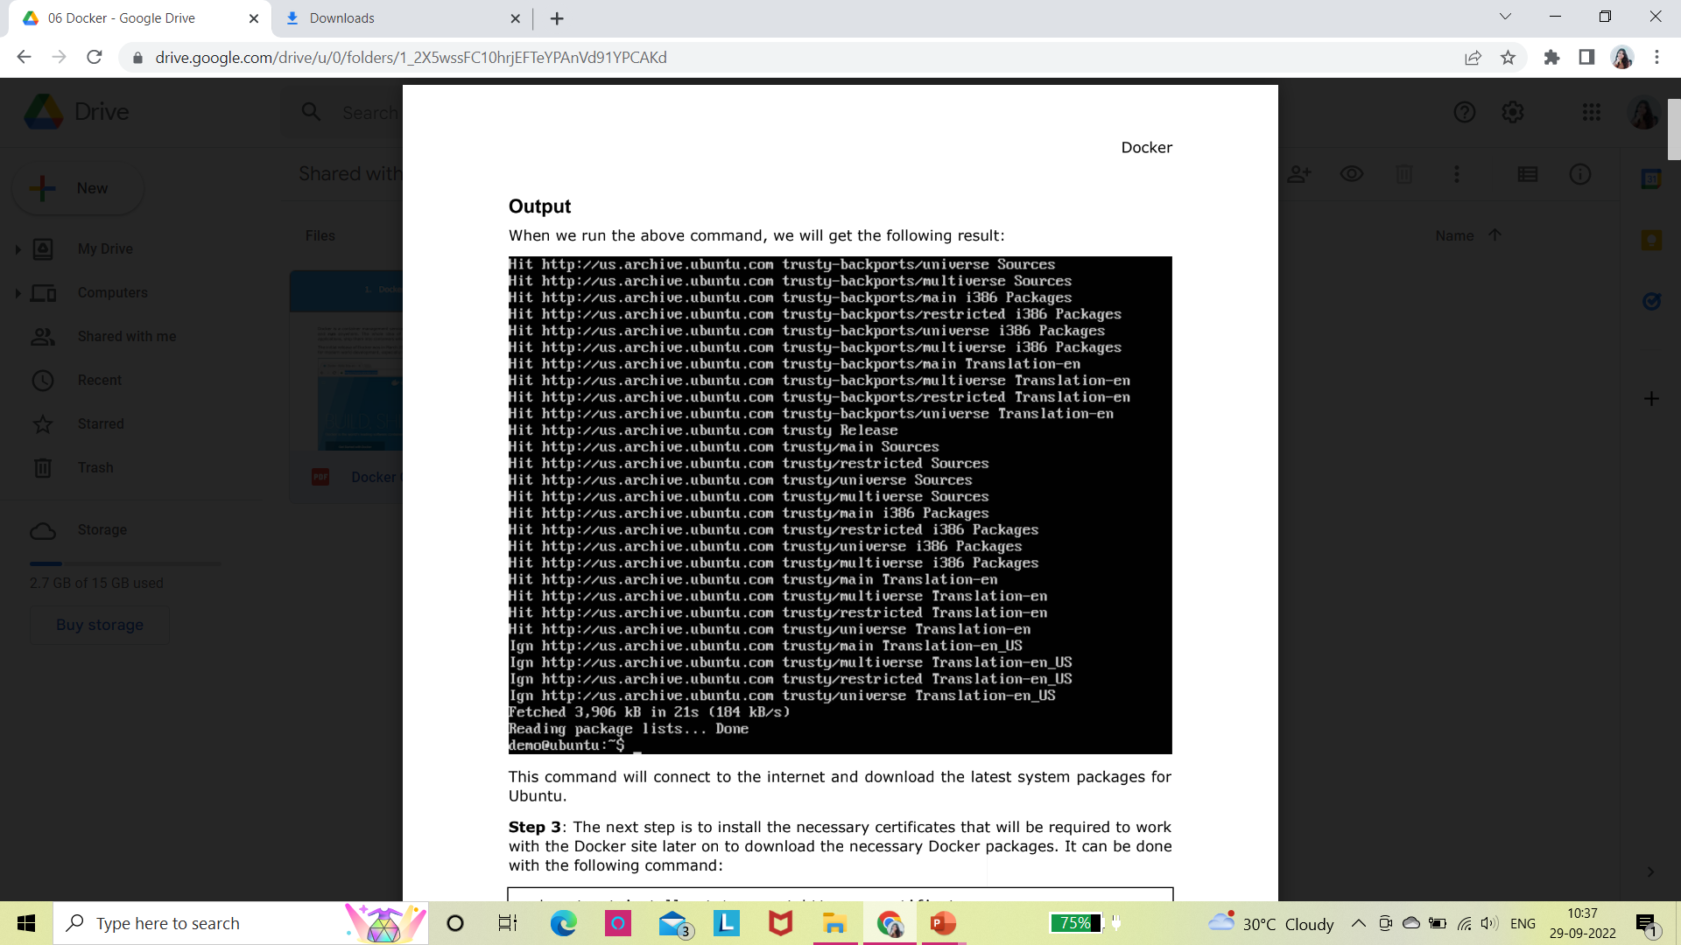
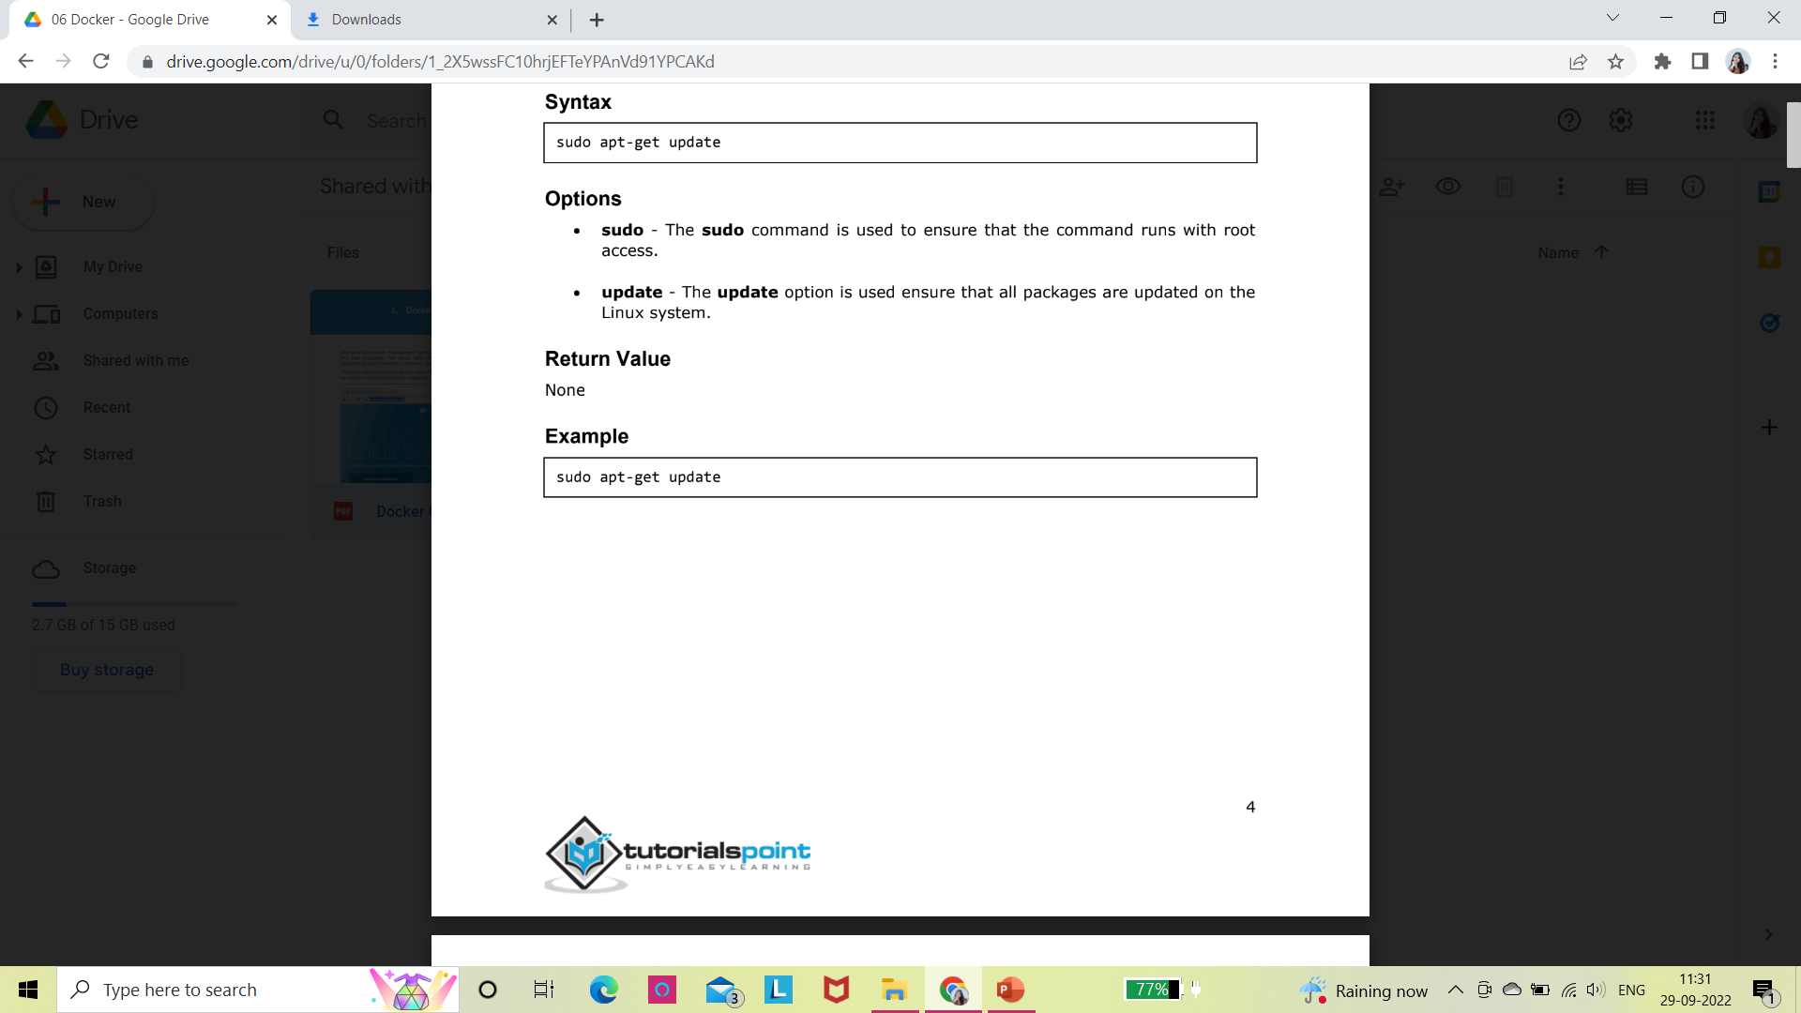
Example
This command will connect to the internet and download the latest system packages for Ubuntu.

Slide 10
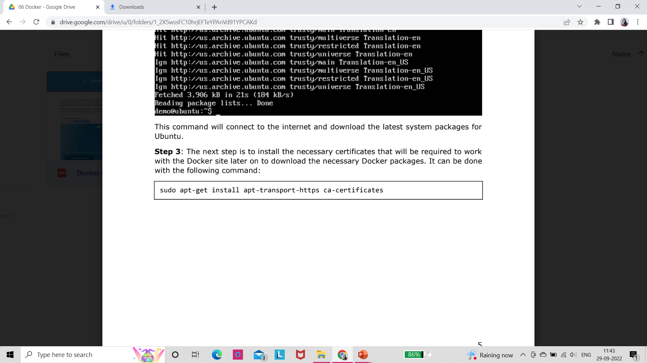
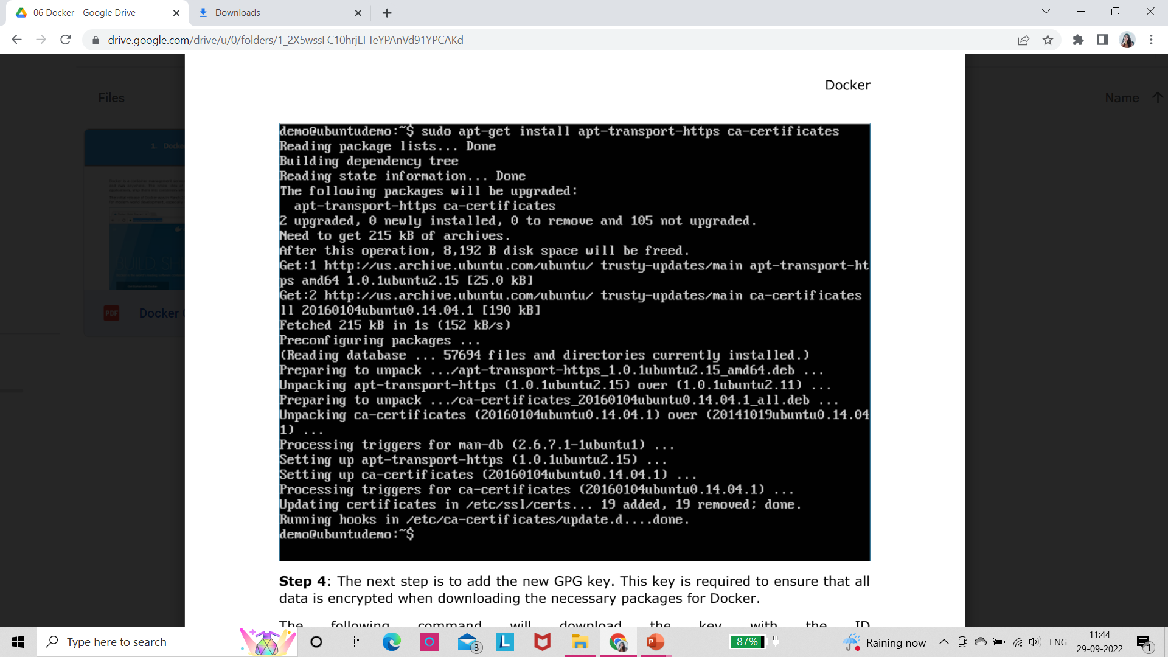
STEP3:
This is to install the necessary certificates that will be required to work with the Docker site later on to download the necessary Docker packages.

Slide 11
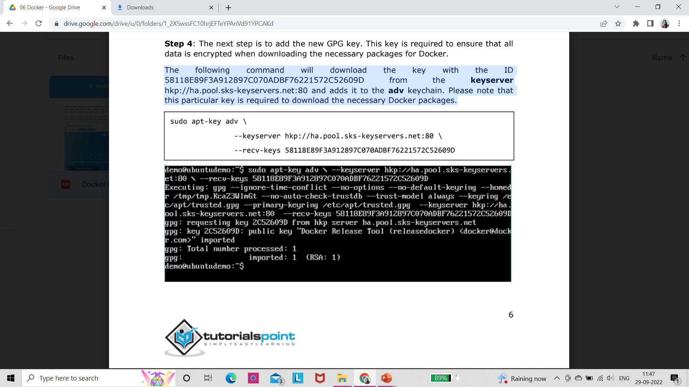
STEP4:
This is to add the new GPG key(GNU Privacy key). This key is required to ensure that all data is encrypted when downloading the necessary packages for Docker.
The command will download the key with the ID 58118E89F3A912897C070ADBF76221572C52609D from the keyserver hkp://ha.pool.sks-keyservers.net:80 and adds it to the adv keychain.
This particular key is required to download the necessary Docker packages.

Slide 12
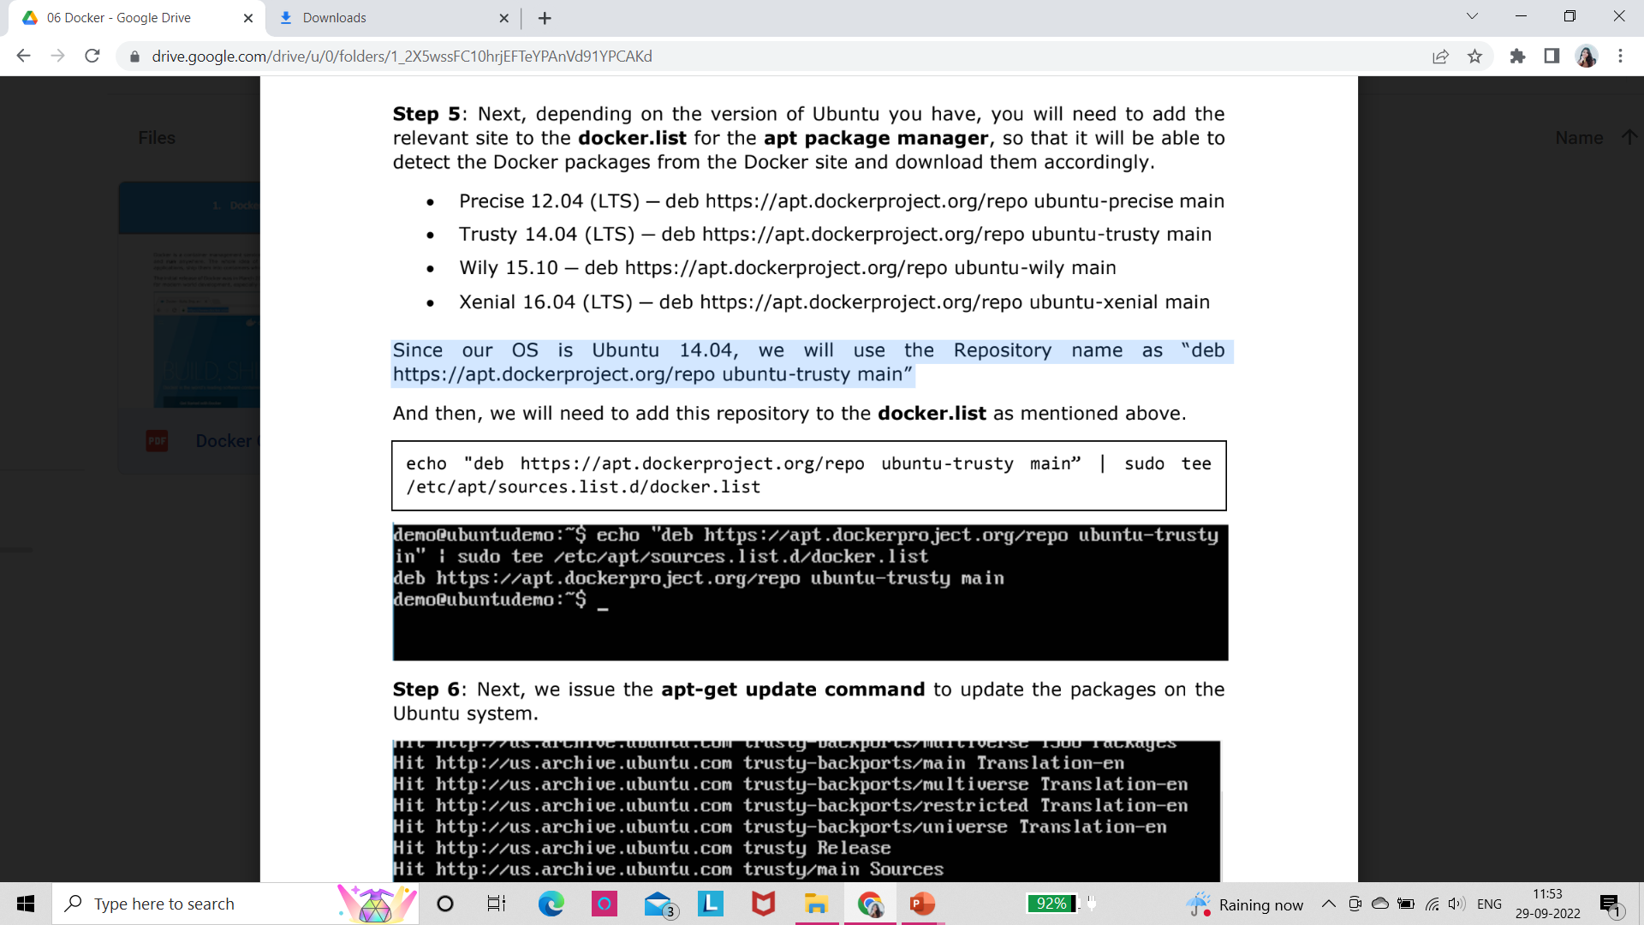
STEP5: Depending on the version of Ubuntu we have, we will need to add the relevant site to the docker.list for the apt package manager, so that it will be able to detect the Docker packages from the Docker site and download them accordingly.
Precise 12.04 (LTS) ─ deb https://apt.dockerproject.org/repo ubuntu-precise main
Trusty 14.04 (LTS) ─ deb https://apt.dockerproject.org/repo ubuntu-trusty main
Wily 15.10 ─ deb https://apt.dockerproject.org/repo ubuntu-wily main
Xenial 16.04 (LTS) ─ deb https://apt.dockerproject.org/repo ubuntu-xenial main
Since our OS is Ubuntu 14.04, we will use the Repository name as “deb
https://apt.dockerproject.org/repo ubuntu-trusty main”

Slide 13
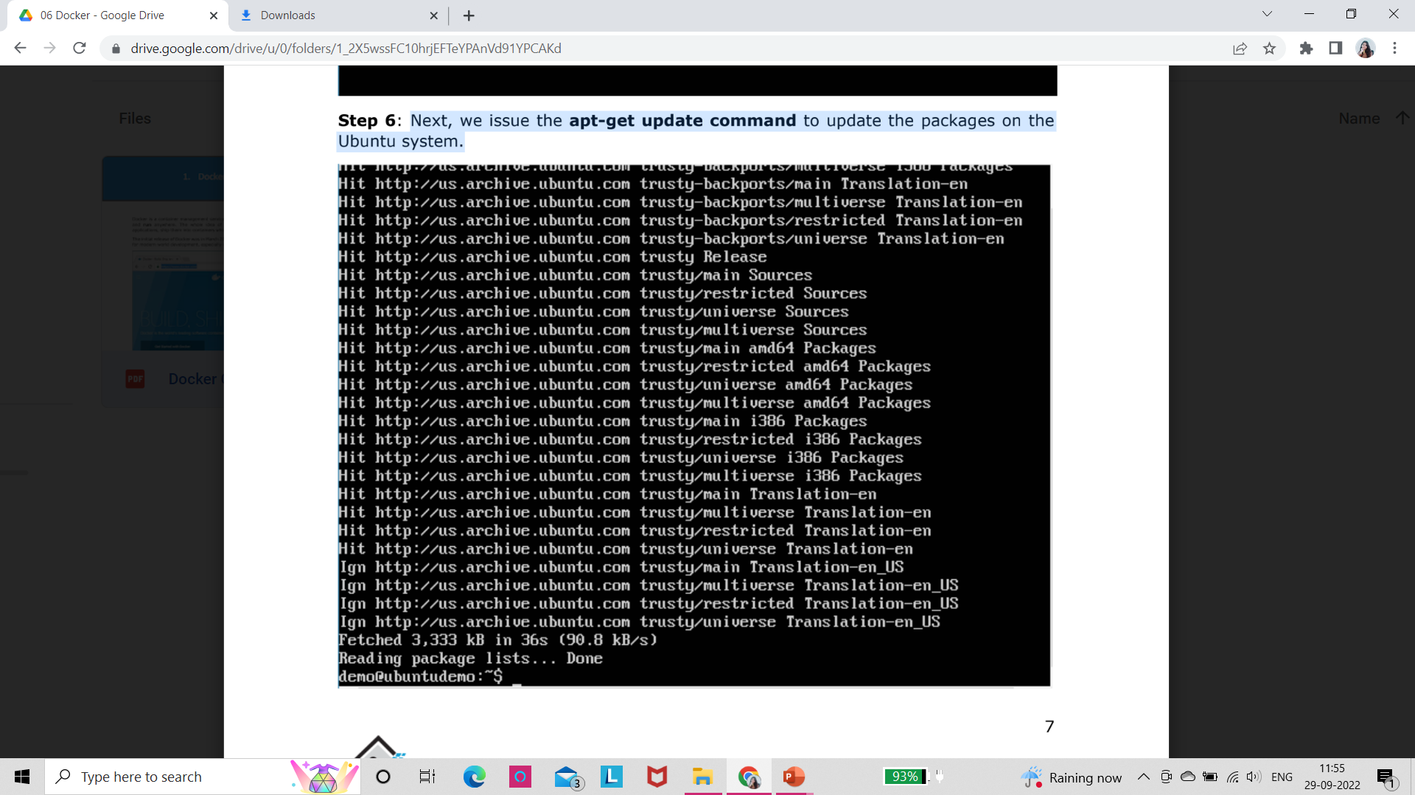
STEP6:
Next, we issue the apt-get update command to update the packages on the Ubuntu system.

Slide 14
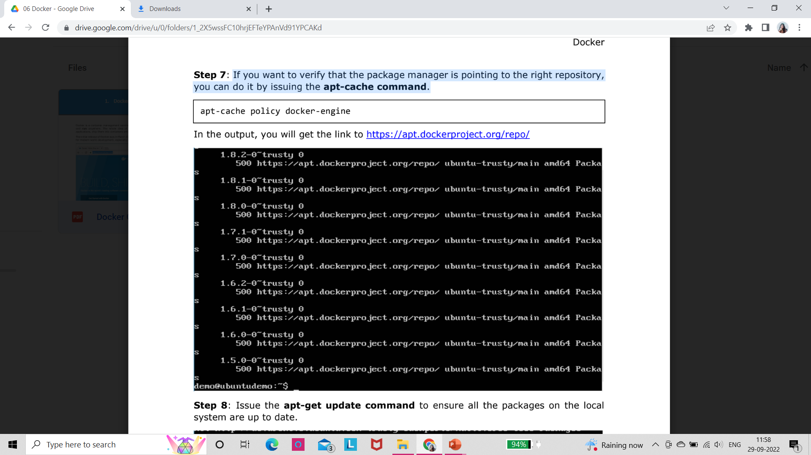
STEP7:
If we want to verify that the package manager is pointing to the right repository, we can do it by issuing the apt-cache command.

Slide 15
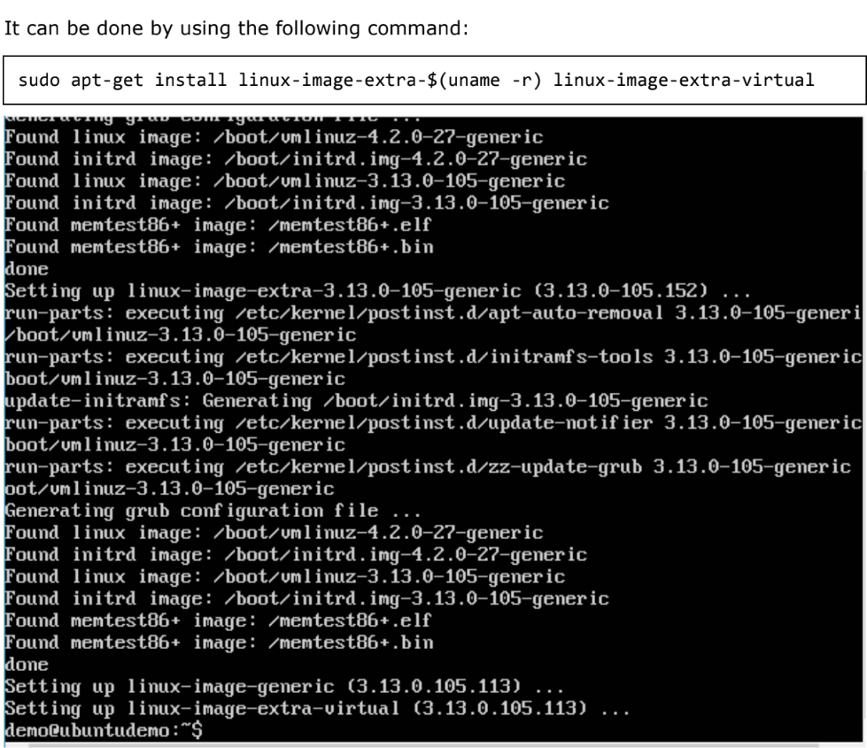
STEP 9:
For Ubuntu Trusty, Wily, and Xenial, we have to install the linux-image-extra-* kernel packages, which allows one to use the aufs storage driver.
This driver is used by the newer versions of Docker.

Slide 16
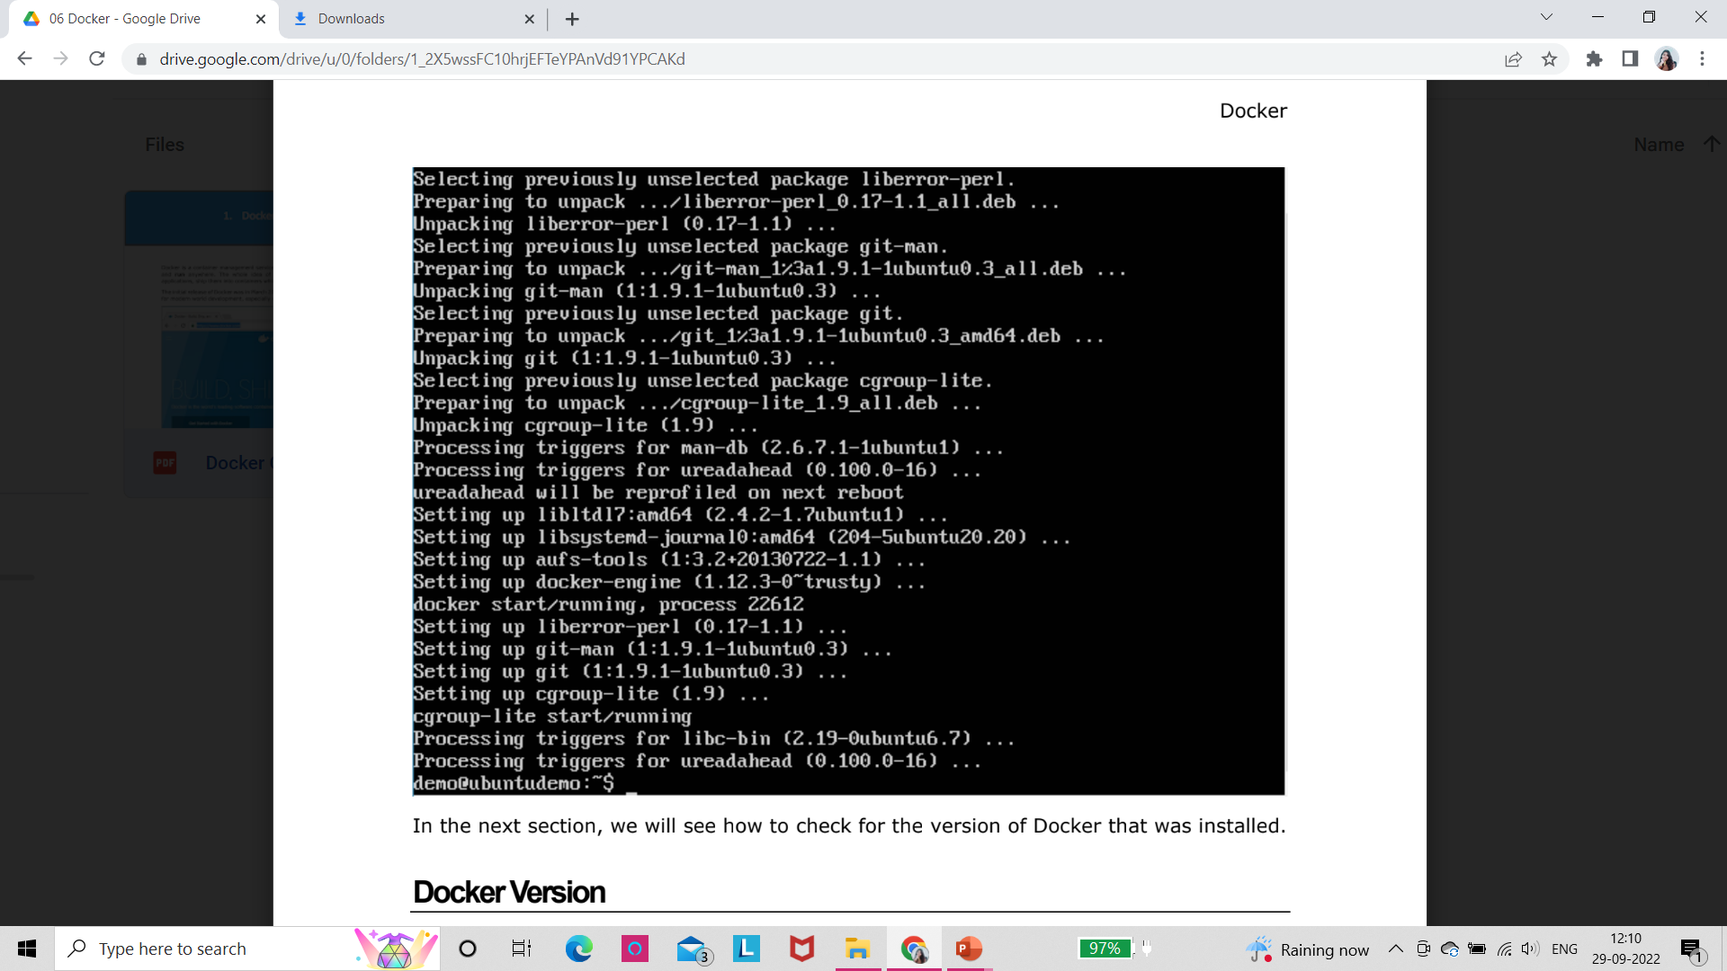
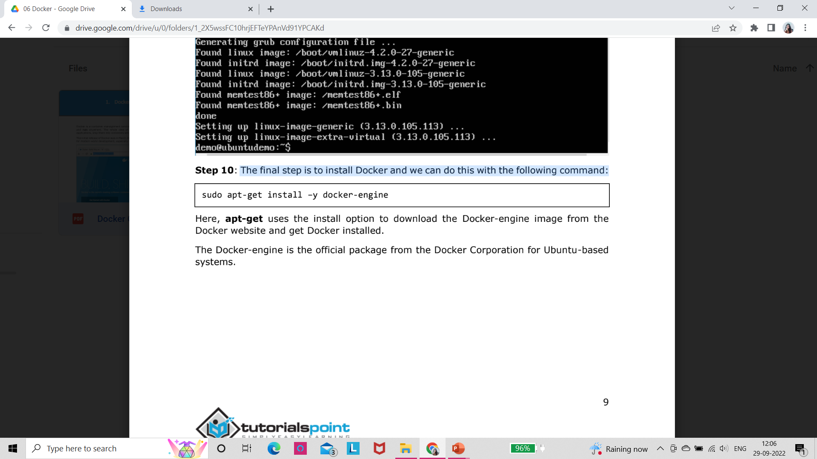
STEP 10:
The final step is to install Docker and we can do this with the following command:
Here, apt-get uses the install option to download the Docker-engine image from the Docker website and get Docker installed.
The Docker-engine is the official package from the Docker Corporation for Ubuntu-based systems.

Slide 17
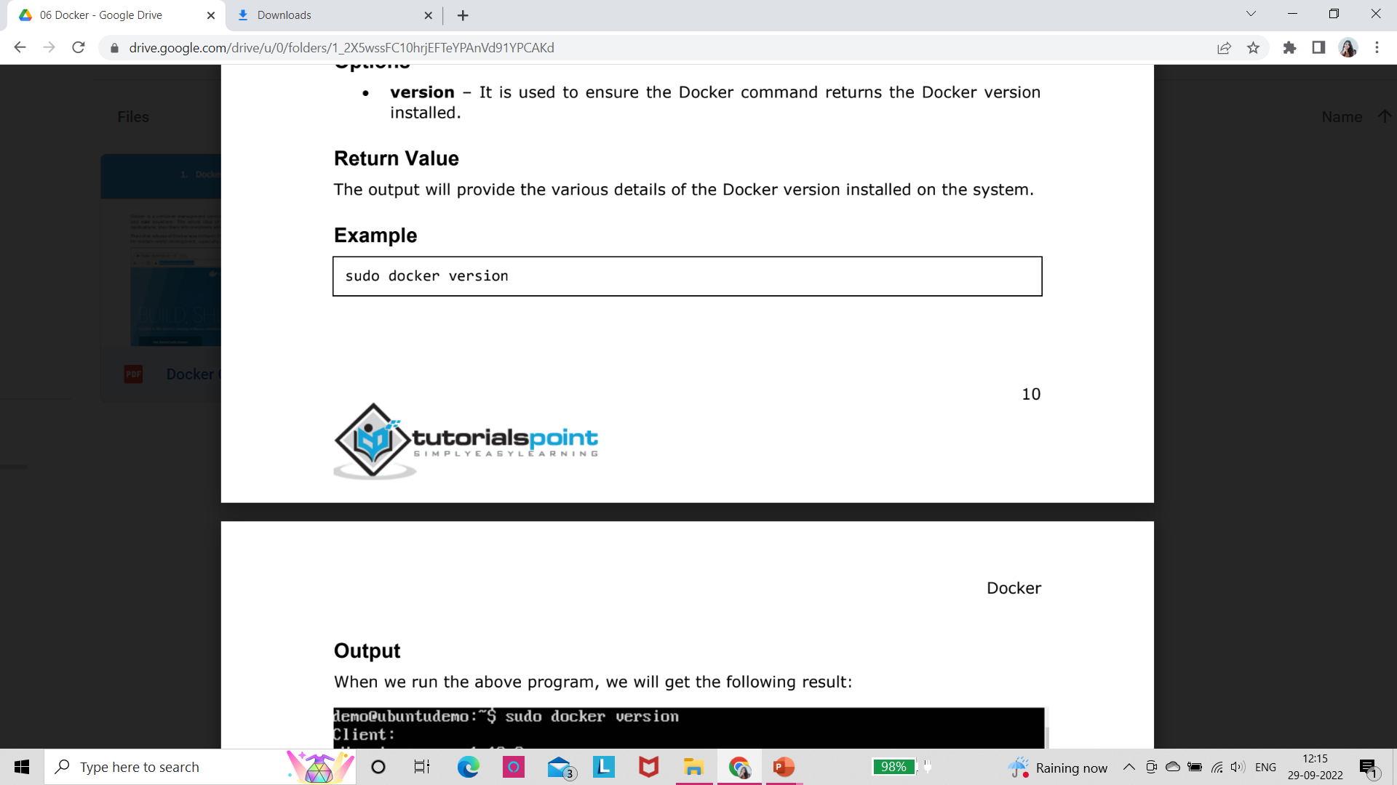
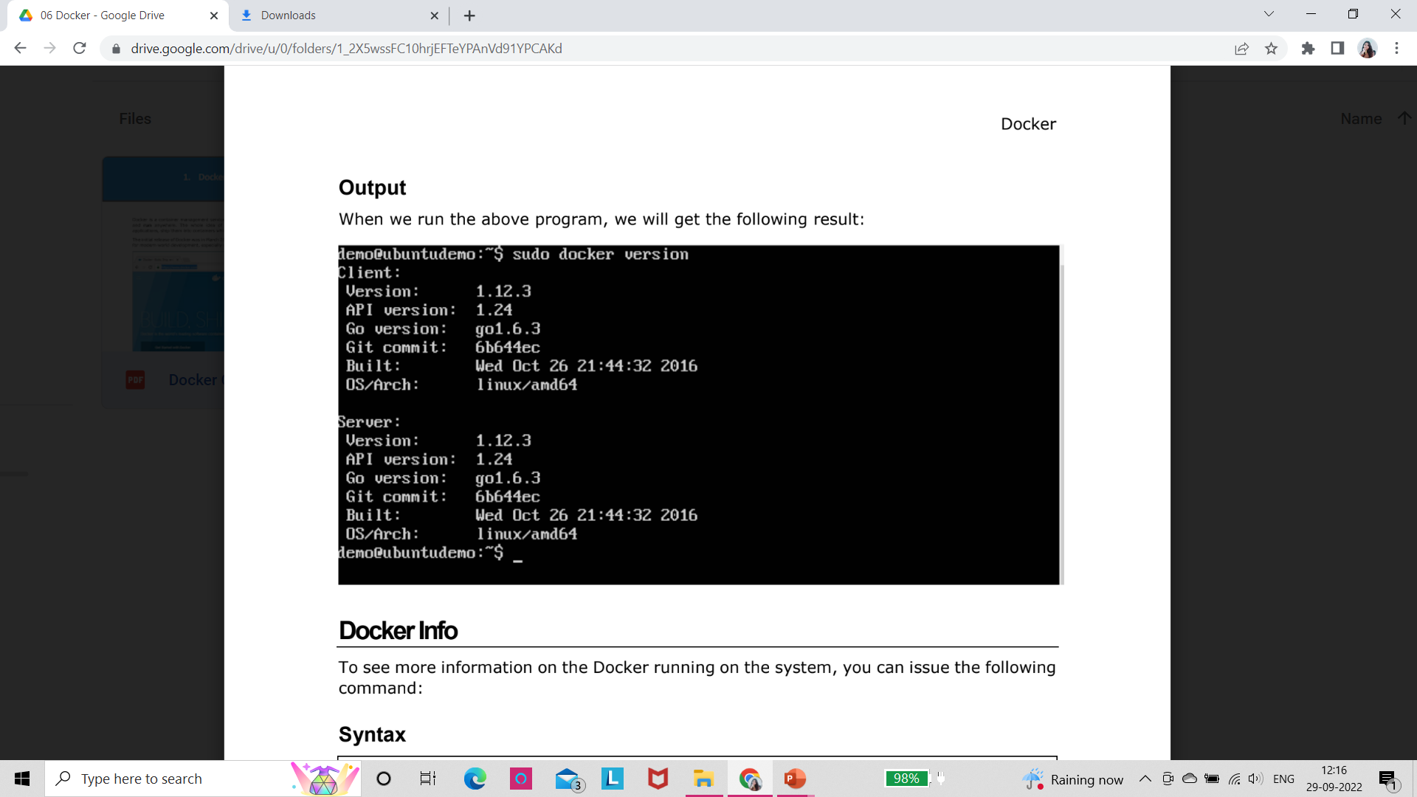
Docker Version
we will see how to check for the version of Docker that was installed.
To see the version of Docker running, we can issue the following command:
Syntax:
docker version
version – It is used to ensure the Docker command returns the Docker version installed.
Return Value
The output will provide the various details of the Docker version installed on the system.

Slide 18
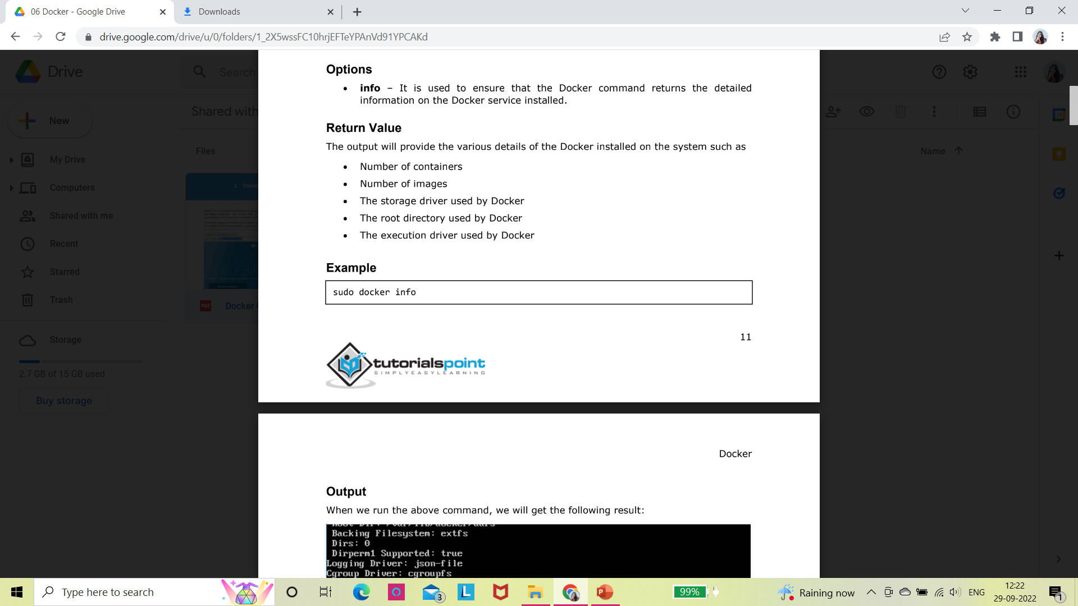
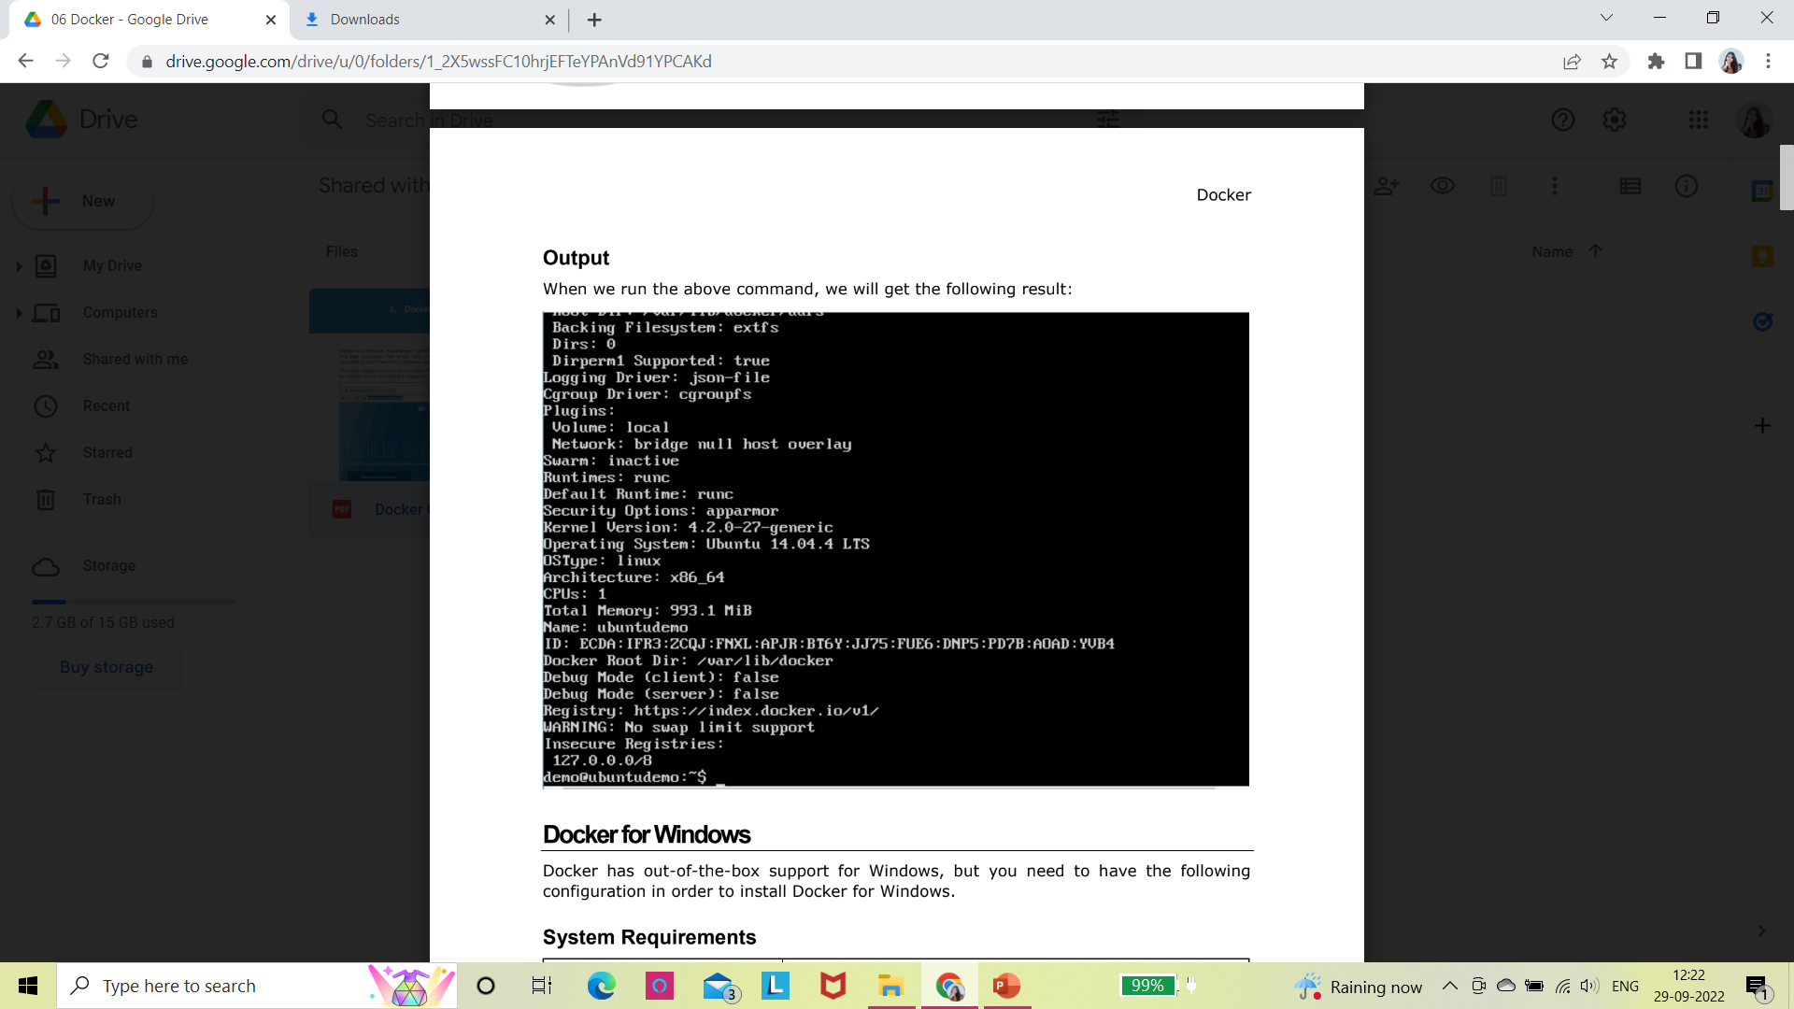
Docker Info
To see more information on the Docker running on the system, we can issue the following command:
Syntax
docker info
info – It is used to ensure that the Docker command returns the detailed information on the Docker service installed.
Return Value
The output will provide the various details of the Docker installed on the system such as
Number of containers
Number of images
The storage driver used by Docker
The root directory used by Docker
The execution driver used by Docker

Slide 19
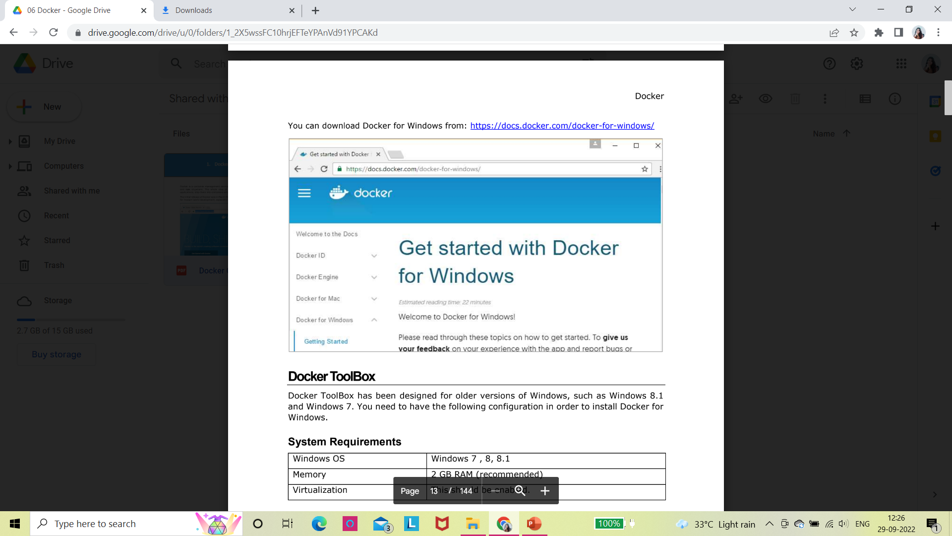
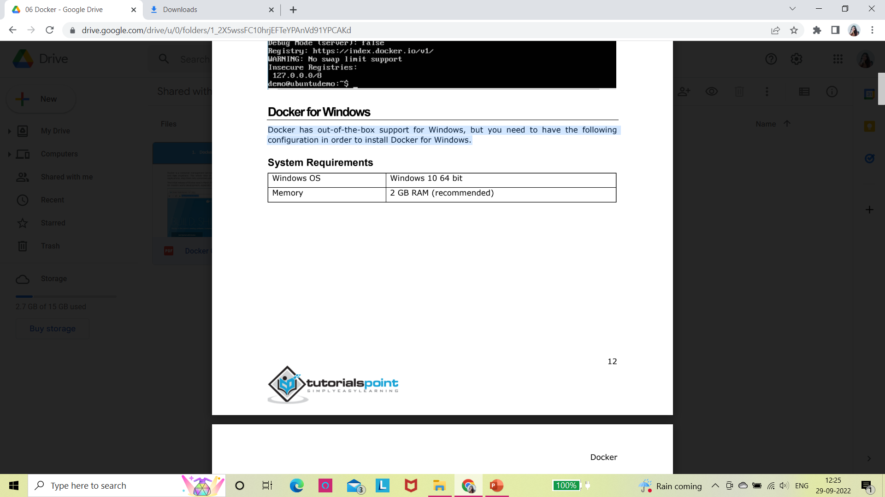
Docker for Windows
Docker has out-of-the-box support for Windows, but we need to have the following configuration in order to install Docker for Windows.

Slide 20
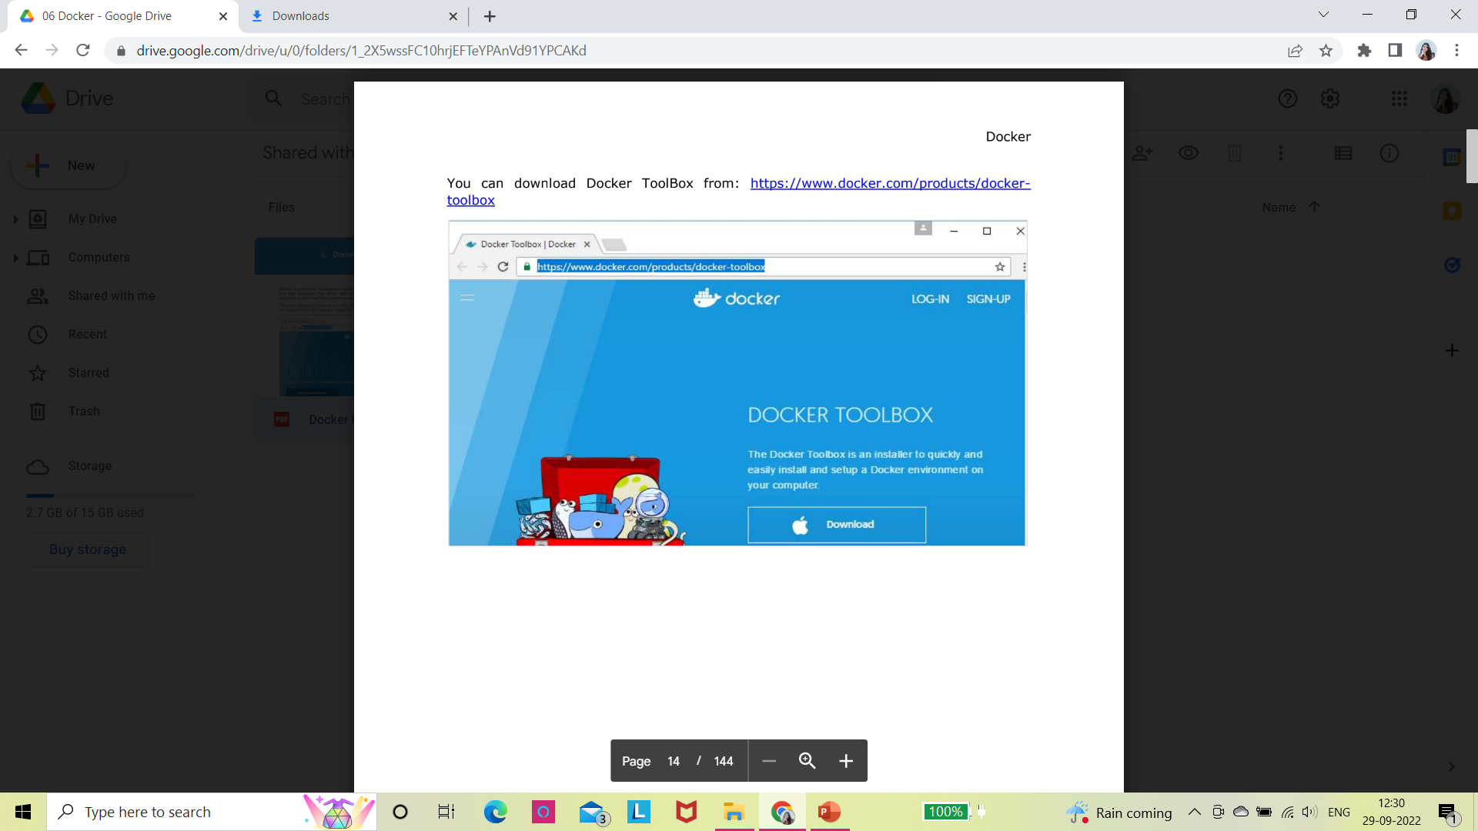
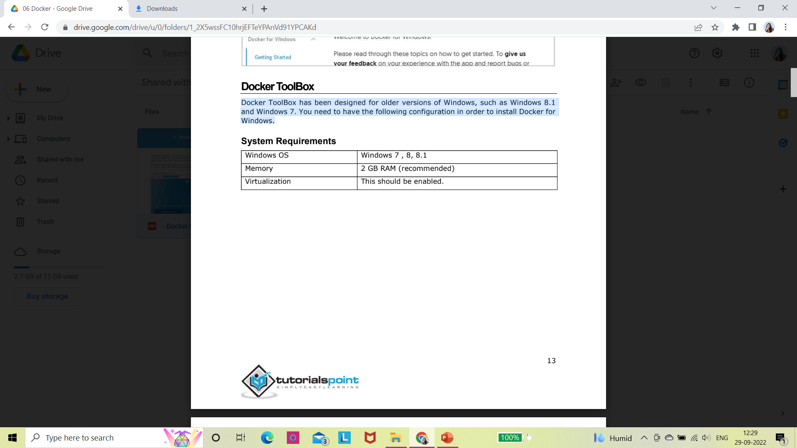
Docker ToolBox
Docker ToolBox has been designed for older versions of Windows, such as Windows 8.1 and Windows 7.
We need to have the following configuration in order to install Docker for Windows.

